Slide 1

Cloud Native Governance + Security
Dave Strebel ( @dave_strebel): Dave.Strebel@Microsoft.com
Kevin Harris ( @kevbhar): Kevin.Harris@Microsoft.com

Slide 2
Agenda
Customer Scenario & Governance + Security Setup
Cluster Pre-Provisioning
Cluster Provisioning
Cluster Post-Provisioning (Infra-centric)
Cluster Post-Provisioning (App-centric)
Cost Governance
Deploy Sample App
Validate Requirements
Blue/Green Deployment
Thought Leadership

Slide 3
Customer Scenario & Governance + Security Setup

Slide 4
What is Enterprise Control Plane (ECP)?
Organize Azure resources:
Management groups, subscriptions, resources groups and resources
Tags
Naming standards
Manage access to Azure resources:
Who has access and at what level ? RBAC and scope
Billing and Chargeback
Pass on the cost to application owners. Ensure the cost transparency.
Governance, security and compliance:
How are Azure resources deployed and configured?
How are Azure resources managed?
Monitoring and reporting:
Centralized view of Azure environment
Controls currency
Adopt Azure evolving features to enhance BMO Enterprise Control plane

Slide 5
BMO "pain" points
Majority of IT operational tasks are not spent on moving business forward
Engineering perceived as "blocker" by Business units

Slide 6
Why Enterprise Control Plane (ECP)?
Application Platform Pipeline – Hit the Ground Running, Not from Scratch
Security Controls on Day 1 – Leverage work done with Security & Risk Teams
Observability – Ability to see which resources are not Compliant to assist with remediation
Identity & RBAC – Access Cloud Resources with a single Identity secured via RBAC
Monitoring & Logging – Centralized Monitoring & Logging to assist with Troubleshooting

Slide 7
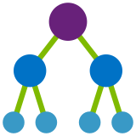



Enterprise Control Plane Architecture
Providing control over the cloud environment, without sacrificing developer agility
Environment factory Deploy and update cloud environments in a repeatable manner using composable artifacts
Policy-based control Real-time enforcement, compliance assessment and remediation at scale
Resource visibility Query, explore & analyze cloud resources at scale
Policy Definitions
Role-based Access
ARM Templates
Azure Portal
CLI
3rd party
Subscriptions
Management Groups
CRUD
Query
Azure Blueprints
Azure Resource Graph
Policy Engine
Azure Resource Manager (ARM)
Virtual Machine
Storage
Network
Resource Provider
Notes:
Lets take a look at how these services fit with each other:
Azure Policy sits on ARM, which means that you can apply policies to every service exposed to ARM.
Blueprints are built from ARM templates, so it is also engrained in the platform
Azure Resource Graph caches all the information from ARM rather than making calls every time you need information, making more efficient the exploration process
Management groups are a feature of the portal, which works along policies and blueprints to make subscription management and governance much easier to implement.

Slide 8
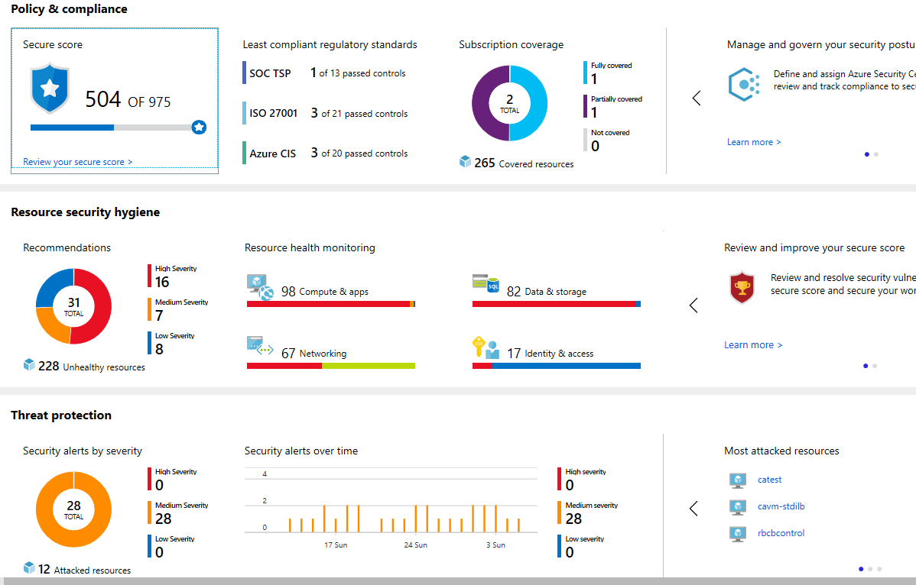
Azure Governance – Compliance
Overall # of Security Controls adhered to across all deployments.
Clear indicator how many Production Subscriptions are BMOcompliant.
Resource Count where security posture is no longer safe for BMO
BMO Resource Count actively attacked with low, medium or high severity.

Slide 9

Introducing Microsoft Azure Sentinel
Cloud-native SIEM for intelligent security analytics for your entire enterprise
Collect
Security data across your enterprise
Limitless cloud speed and scale
Bring your Office 365 data for Free
Easy integration with your existing tools
Faster threat protection with AI by your side
Respond
Detect
Rapidly and automate protection
Azure Sentinel
Threats with vast threat intelligence and AI
Investigate
Critical incidents guided by AI
Notes:
That’s why we re-imagined the SIEM + SOAR tool to introduce a new cloud-native solution called Microsoft Azure Sentinel - providing intelligent security analytics at cloud scale for your entire enterprise.
Azure Sentinel makes it easy to collect security data across your entire hybrid organization from devices, users, apps, servers and any cloud, it uses the power of artificial intelligence to ensure you are identifying real threats quickly, and unleashes you from the burden of traditional SIEMs by eliminating the need to spend time on setting up, maintaining and scaling infrastructure.
Since it is built on Azure, it offers limitless cloud scale and speed, scaling automatically to address your needs.
Traditional SIEMs have also proven to be expensive to own and operate, often requiring you to commit upfront and incur high cost for infrastructure maintenance and data ingestion. With Azure Sentinel there will be no upfront costs, you will only pay for what you use, and we are offering free Office 365 activity data import to help you reduce security costs significantly

Slide 10
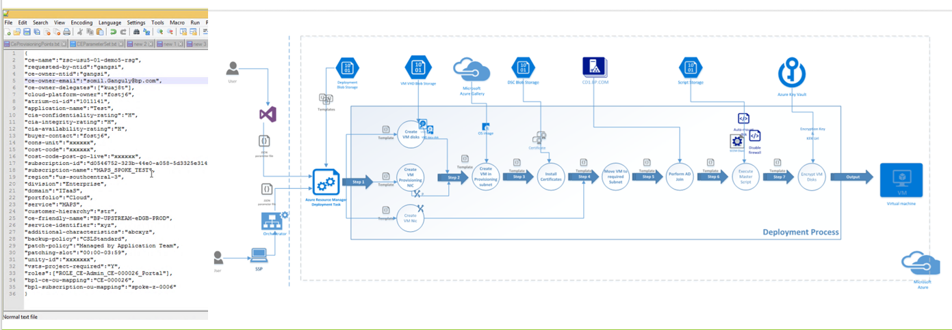
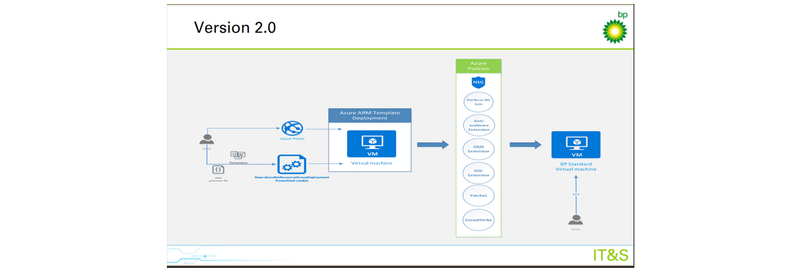
Azure Governance – In Practice
Before
After
Opened Azure Dashboard for use yet assured governed desired state.
Use of Azure Policies

Slide 11
Agenda
Pre-Provisioning Security
Provisioning Security
Cluster/Node Security
Workload Security
AKS/Azure Specific Security

Slide 12
Cluster Pre-Provisioning

Slide 13
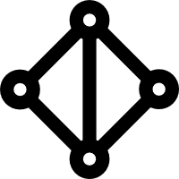
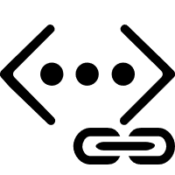
Scenarios enabled by Advanced Networking
Uses Azure subnet for both your containers and cluster VMs
1
On-premises infrastructure
3
Azure VNet A
Enterprise system
Allows for connectivity to existing Azure services in the same VNet
Backend services subnet
AKS subnet
Azure Express Route
AKS cluster
SQL Server
Use Express Route to connect to on-premises infrastructure
Azure SQL PaaS DB
5
Use VNet peering to connect to other VNets
2
Service Endpoint
Connect AKS cluster securely and privately to other Azure resources using VNet endpoints
VNet peering
Other peered VNets
4
AKS VNet integration works seamlessly with your existing network infrastructure

Slide 14
Advanced networking: Prerequisites
The virtual network for the AKS cluster must allow outbound internet connectivity.
Don't create more than one AKS cluster in the same subnet.
AKS clusters may not use 169.254.0.0/16, 172.30.0.0/16, or 172.31.0.0/16 for the Kubernetes service address range.
The service principal used by the AKS cluster must have at least Network Contributor permissions on the subnet within your virtual network. If you wish to define a custom role instead of using the built-in Network Contributor role, the following permissions are required:
Microsoft.Network/virtualNetworks/subnets/join/action
Microsoft.Network/virtualNetworks/subnets/read

Slide 15
Advanced networking: Planning IP addressing for your cluster
Azure VNet
Frontend
Data tier
AKS
Subnet
1565
(> /21)
App tier
50
(50 * 30)
15
Additional subnets
Kubernetes service address range
Non-overlapping with other subnets in your network (does not need to be routable) and not 169.254.0.0/16, 172.30.0.0/16 and 172.31.0.0/16.
Smaller than /12
Docker bridge address
Non-overlapping with AKS Subnet

Slide 16
Summary
Capability | Kubenet | Azure CNI
Deploy cluster in existing or new virtual network | Supported | Supported
Pod-pod connectivity | Supported | Supported
Pod-VM connectivity; VM in the same virtual network | Works when initiated by pod | Works both ways
Pod-VM connectivity; VM in peered virtual network | Works when initiated by pod | Works both ways
On-premises access using VPN or Express Route | Works when initiated by pod | Works both ways
Access to resources secured by service endpoints | Supported | Supported
Multiple clusters/resources per Subnet | Not-Supported | Supported
Default Azure DNS and Private Zones | Supported | Supported
Support egress lockdown and custom UDRs | Supported*** | Supported

Slide 17
Cluster Provisioning

Slide 18



Security overview
Internal User
External User
͏Image and container level security
AAD authenticated Container registry access
ACR image scanning and content trust for image validation
Azure Container Registry
App Gateway
Developer
AKS with RBAC
1
Internal Load Balancer
External Load Balancer
Azure VNet
Active Directory
Ingress Controller
Ingress Controller
External DNS
Node
Node
Pod
Pod
3
2
AAD Pod Identity

Slide 19
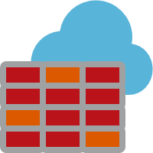
North/South Traffic in AKS with Azure Firewall
L3-L7 Connectivity Policies
Target FQDN
*.azmk8s.io (Eg. *eastus.azmk8s.io) – API Server
aksrepos.azurecr.io – Microsoft Images
*mcr.microsoft.com – Microsoft Images
*security.ubuntu.com – Ubuntu Security Updates
login.microsoftonline.com - AAD
management.azure.com – Azure API
AKS Subnet
NAT, Network and Application traffic filtering rules allows Inbound/Outbound access
Firewall Subnet
AKS Subnet
Azure Firewall
NAT Rules
TCP Port 9000, 22 and 443 for API server FQDN and IP Address TCP port 443 for the above FQDNs
AKS Clusters
Azure to On-Prem traffic filtering
Traffic is denied by default
On-Premises

Slide 20




Node Management Through Azure Bastion
On-premises infrastructure
Azure Management VNET
Admin
Enterprise system
Azure Bastion Subnet
APP GW Subnet
Azure Bastion
Azure Express Route
Azure AKS VNet
VNet peering
Private IP
AKS subnet
Internal LB
AKS cluster
Ingress
contoso.com/A
contoso.com/B
service.contoso.com
ServiceA
ServiceB
ServiceC

Slide 21
Cluster Post-Provisioning (Infra-Centric)

Slide 22
Security overview
Internal User
External User
Azure Container Registry
App Gateway
͏Node and cluster level security
Automatic security patching nightly
Nodes deployed in private virtual network subnet w/o public addresses
Network policy to secure communication paths between namespaces (and nodes)
Pod Security Policies
K8s RBAC and AAD for authentication
Namespaces
Developer
AKS with RBAC
1
Internal Load Balancer
External Load Balancer
Azure VNet
Active Directory
Ingress Controller
Ingress Controller
External DNS
Node
Node
Pod
Pod
3
2
AAD Pod Identity

Slide 23

East/West Traffic with Network Policy
Kubernetes cluster
Kubernetes Network Policy
Control network traffic within the cluster
Restrict pod⬄ pod communication in a cluster
Choice of plugins: Azure-native or OSS Calico project

Slide 24
Cluster Security
Azure AD integration
API Server Whitelisting
Public end point; accessible from any client
Needs to be locked down to specific CIDR’s
Node Patching
Platform managed patches
Cluster aware reboots
Azure Policy for AKS
Automate policy enforcement for Kubernetes
Capture policies in a declarative format

Slide 25
When to use Azure NSG/FW vs. Kubernetes Network policy
Azure Network Security Groups and FW
Use it to filter North-South traffic, that is, traffic entering and leaving your cluster subnet
Kubernetes Network Policies
Use it to filter East-West traffic, that is, traffic between pods in your cluster

Slide 26
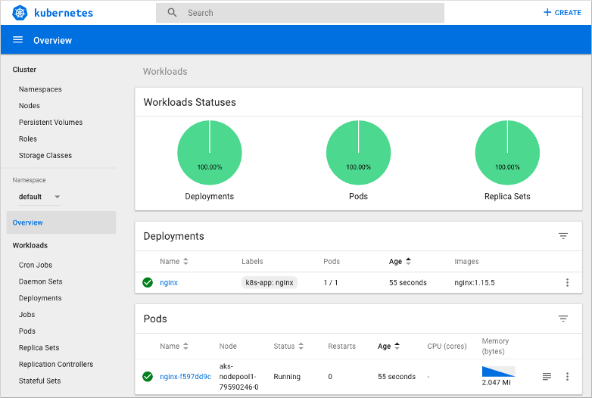
Kubernetes Dashboard

Slide 27
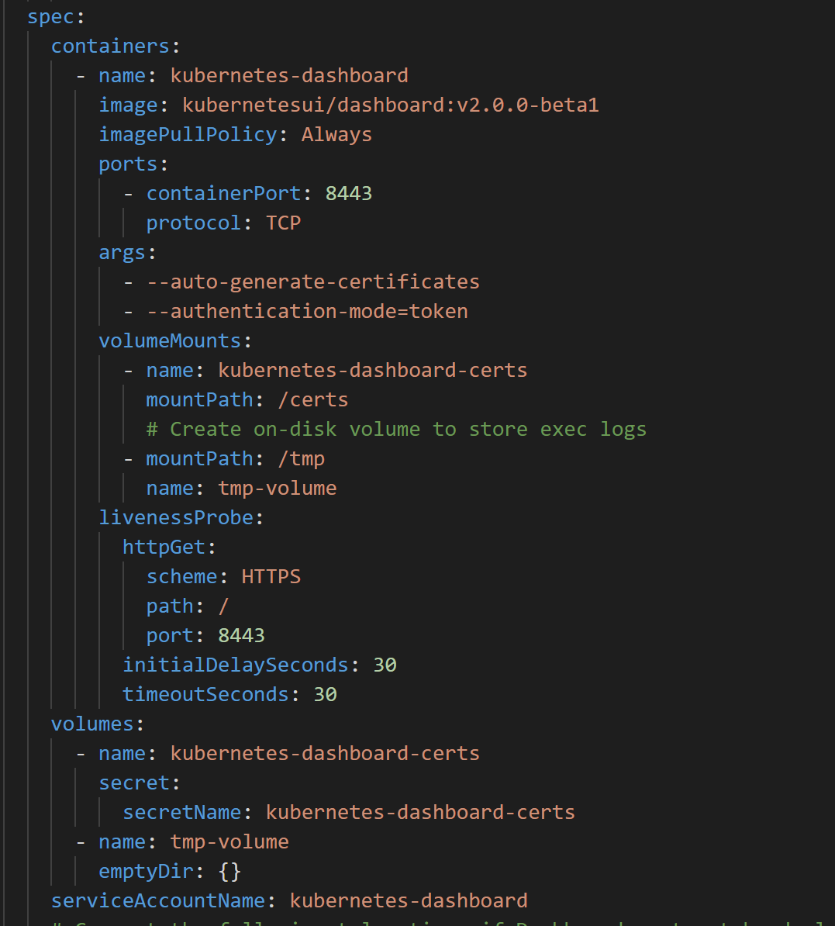
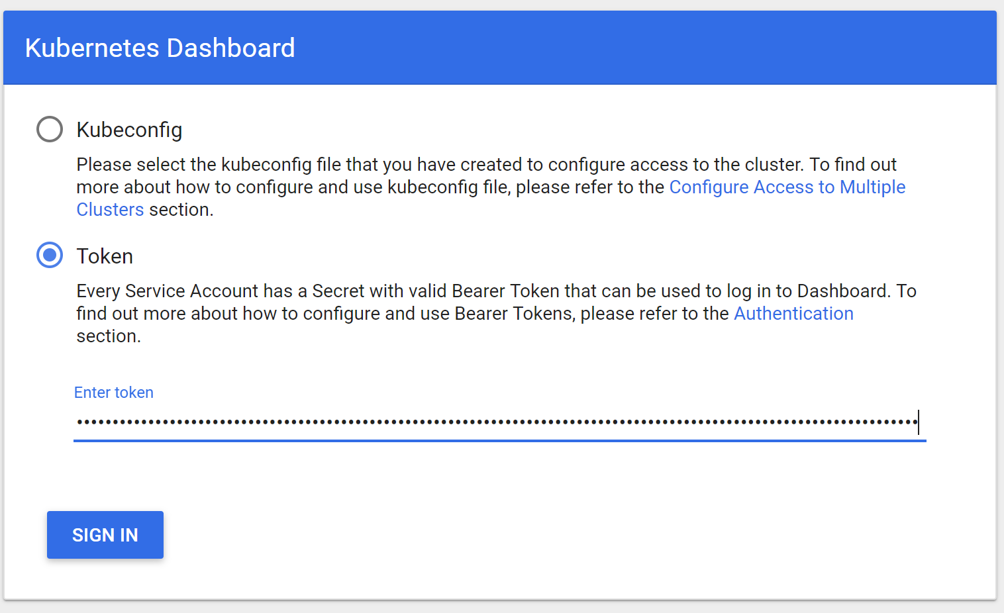
Kubernetes Dashboard – less worse

Slide 28
What to be careful when monitoring Kubernetes?
Workloads
Health, performance, SLA (create, start, end)
Restart counts
Crash loop
Workload Sizing and Tuning
noisy neighbor
limits/requests per workload – oversubscription
pod anti-affinity – distribution of containers among nodes
Cluster (Orchestrator) “itself”
etcd, kube-api, increasing pending pods can pause any deployment running
capacity – do I need to scale up/down?
Platform – Node, Network, Storage

Slide 29








Azure Monitor for Containers
Cloud Native experience to Azure Monitor with Prometheus integration.
Observe live container logs and Kubernetes event log on container deployment status
Visualize overall health and performance from cluster to containers with drill downs and filters.
Insightful Monitoring
and Alerting
Visualization
1
Observability
2
Provide insights with multi-cluster health roll up view.
Insights
Azure Pipeline
Azure Kubernetes Service
Azure Monitor
for Containers
Monitor and analyze Kubernetes and container deployment performance, events, health, and logs
Monitor
Analyze
AKS Virtual Node
Native alerting with integration to issue managements and ITSM tools.
Response

Slide 30
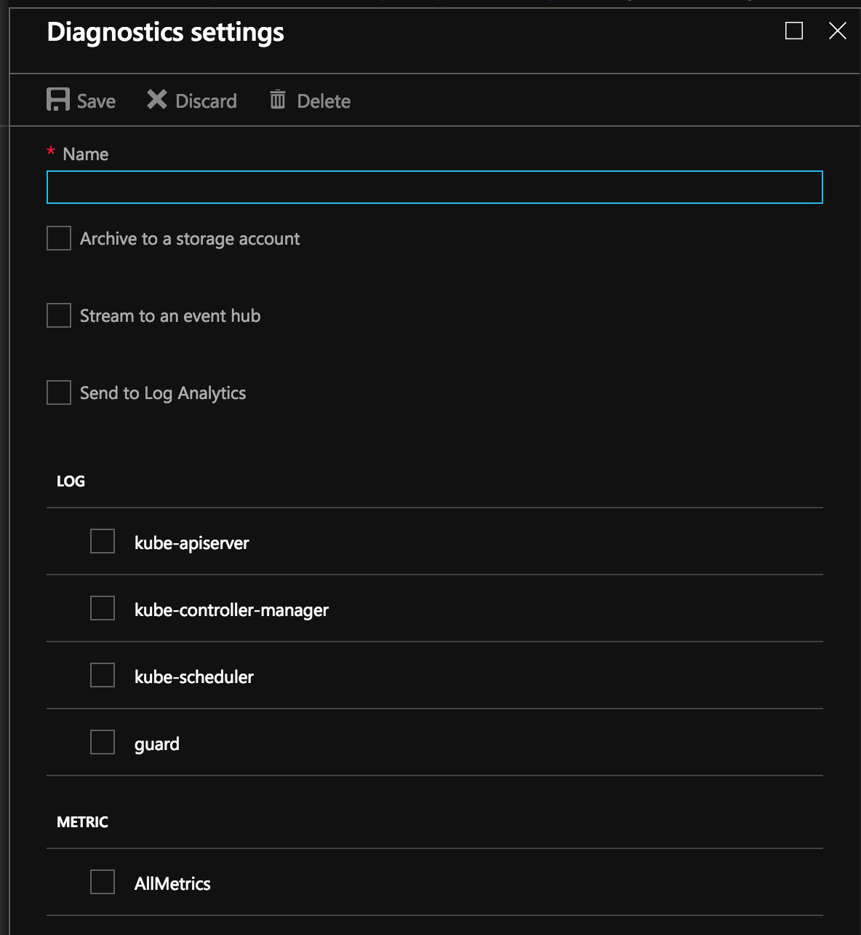
Enable Control plane logs
Use the Azure portal to enable diagnostics logs
Pipe logs to Log Analytics, Event Hub or a storage account
Metrics available today
kube-controller-manager
kube-api-server
kube-scheduler
Audit logs (new)

Slide 31
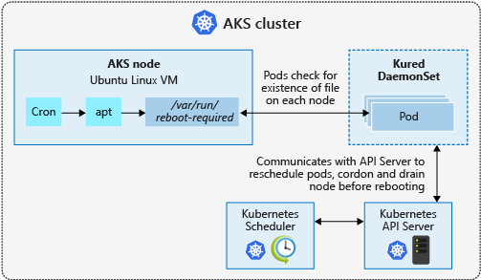
Process Node OS Security Patches
AKS automatically applies security patches to the nodes on a nightly schedule
You’re responsible to reboot as required
Regular maintenance recommended
Monthly ideal, 3 months maximum
Use Kured DaemonSet to watch for nodes requiring a reboot and handle the reschedule of the pods and reboot of the nodes. Check AKS documentation for guidance to use Kured

Slide 32
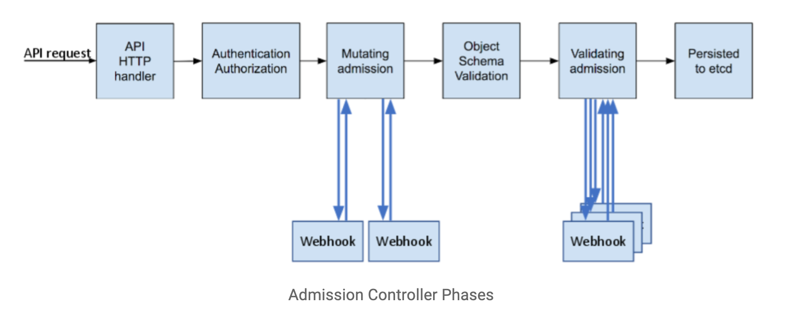

Slide 33
Dynamic Admission Control
Validating Webhook
Allows you to intercept and validate requests
Can be run in parallel, as they don’t mutate objects
Example use case: restricting resource creation
Mutating Webhook
Executes the mutation by sending requests to webhook server
Matching webhooks are called in serial
Example use case: injecting side cars
Policy Enforcement
Admission Control is policy based on Kubernetes objects.
Network Policy and PodSecurity Policy focus on data plane policy
RBAC is policy enforced on the user
Notes:
Talk more of what can Dynamic Admission controllers are and their use cases
; each one may modify the object if it desires

Slide 34

That’s awesome! But…
Notes:
So yes dynamic controllers are awesome, but they create a lot of custom code that has to be mainted and configured in Kubernetes

Slide 35
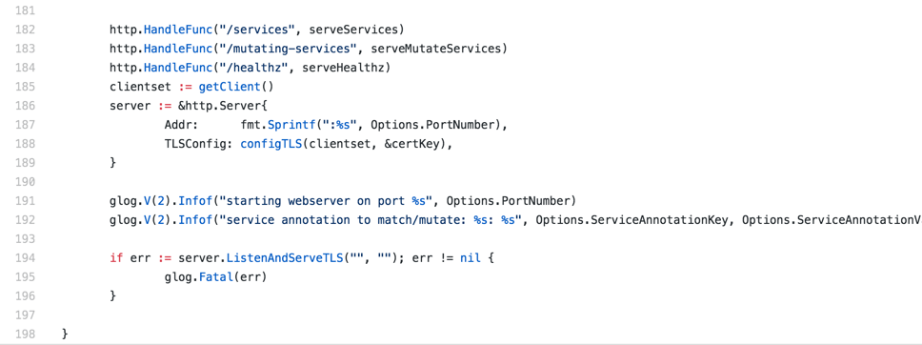
Sample Admission Webhook

Slide 36
Open Policy Agent
CNCF Hosted Sandbox Project
General purpose policy engine
Can be used across the stack
Declarative policy language (Rego)
Image: openpolicyagent.org
Notes:
Overview key features of the Open Policy Agent

Slide 37
Request
Service refers to:
Kubernetes API
Custom API
SSH Daemon
Terraform
Authorization APi
Service
Enforcement
Policy
Query
Policy
Decision
OPA
Input can be any JSON value:
"kind": "Service",
"metadata": {
"annotations": {
department: dev
}
Output can be any JSON value:
”true
”request annotated” “ “annotations": {
costCenter: 8000
}
Policy
(Rego)
Data
(JSON)
Diagram rewritten from: www.openpolicyagent.org
Notes:
More detail in how Open Policy agent makes enforcement decisions

Slide 38
Example Rego Policy
Rego is a policy language and not a programing language, so don’t think about sockets, methods, binary trees, etc.
Think about two things: Logic and Data
Rego logic is all queries. A query finds values for variables that make boolean conditions true.
You write logic to search and combine JSON/YAML data from different sources.
deny[{
"id": "conditional-annotation",
"resource": {"kind": kind, "namespace": namespace, "name": name},
"resolution": {"patches": p, "message" : "conditional annotation"}, }] {
matches[[kind, namespace, name, matched_object]] matched_object.metadata.annotations[”Mr-T"]
p = [{"op": "add", "path": "/metadata/annotations/cost-center", "value": ”A-Team"}] }
Notes:
Outline rego and a sample policy

Slide 39
Who manages all this policy?
Developer
Deploys Apps
Ice Kube
OPA Policy
Audits Platform
Platform Operator
Creates And Maintains
The Governor
Acid Burn

Slide 40
Kubernetes Policy Controller
Kubernetes Policy Controller
Moving to OPA org, as a standard Kubernetes Policy Controller
Authorization module makes it possible to implement a blacklist in front of RBAC
Provides auditing features
Deployment consist of three containers: OPA, kube-mgmt., and Controller
Examples:
Whitelist / blacklist registries.
Not allow conflicting hosts for ingresses.
Label objects based on a user from a department.
Block kubectl exec <pod>
Notes:
General Overview of of the Kubernetes Policy Management Controller

Slide 41
The Good, The Bad, and Gotchas
Good
OPA approach allows you to decouple policy from your applications
General purpose, so can be used outside of Kubernetes context.
Bad
There can be a learning curve to Rego.
Can cause latency, but’s negligible for most apps. (more of a consideration)
Gotchas
Mutating objects need to be handled with care. They can cause unexpected behavior to what the end-user expects.
Notes:
Talk about takeaways and what attendees learned and renforce how OPA\Policy controller solves the Problem from first few slides

Slide 42
Pop Quiz #1
Applying an Azure Firewall in front of the AKS cluster to limit egress traffic will help me prevent pods in a cluster from interacting with each other
True
False
B) False

Slide 43
Cluster Post-Provisioning (App-Centric)

Slide 44
Security overview
Internal User
External User
Azure Container Registry
App Gateway
Developer
AKS with RBAC
1
Internal Load Balancer
External Load Balancer
Azure VNet
3. Workload level security
Azure Role-based Access Control (RBAC) & security policy groups
Secure access to resources & services (e.g. Azure Key Vault) via Pod Identity
Storage Encryption
Ingress Controller with WAF to protect against threats and intrusions
Active Directory
Ingress Controller
Ingress Controller
External DNS
Node
Node
Pod
Pod
3
2
AAD Pod Identity

Slide 45
Ingress
On-premises infrastructure
Enterprise system
kind: Ingress
metadata:
name: contoso-ingress
annotations: kubernetes.io/ingress.class: ”PublicIngress"
spec:
tls:
- hosts:
- contoso.com
secretName: contoso-secret
rules:
- host: contoso.com
http:
paths:
- path: /a
backend:
serviceName: servicea
servicePort: 80
- path: /b
backend:
serviceName: serviceb
servicePort: 80
Azure Express Route
Azure AKS VNet
Private IP
Public IP
Public LB
Internal LB
AKS subnet
AKS cluster
PublicIngress
PrivateIngress
contoso.com/A
contoso.com/B
serviceC.contoso.com
ServiceA
ServiceB
ServiceC

Slide 46
Securing Kubernetes Services with WAF
Azure Management VNET
Ingress ControllerSubnet
Azure AKS VNet
VNet peering
Private IP
AKS subnet
Internal LB
AKS cluster
Ingress
contoso.com/A
contoso.com/B
service.contoso.com
ServiceA
ServiceB
ServiceC

Slide 47
Pop Quiz #2
Applying specific CIDR ranges to access the API server keeps the traffic between the API server and node pool private?
True
False
B) False

Slide 48
Cost Governance

Slide 49
Cost Governance
KubeCost
Notes:
Talk about takeaways and what attendees learned and renforce how OPA\Policy controller solves the Problem from first few slides

Slide 50
Deploy Sample App

Slide 51
Deploy Sample App
???
Notes:
Talk about takeaways and what attendees learned and renforce how OPA\Policy controller solves the Problem from first few slides

Slide 52
Validate Requirements

Slide 53
Validate Requirements
???
Notes:
Talk about takeaways and what attendees learned and renforce how OPA\Policy controller solves the Problem from first few slides

Slide 54
Blue/Green Deployment

Slide 55
Blue/Green Deployment
???
Notes:
Talk about takeaways and what attendees learned and renforce how OPA\Policy controller solves the Problem from first few slides

Slide 56
Thought Leadership

Slide 57
Thought Leadership
SMI
Haiku
Notes:
Talk about takeaways and what attendees learned and renforce how OPA\Policy controller solves the Problem from first few slides

Slide 58
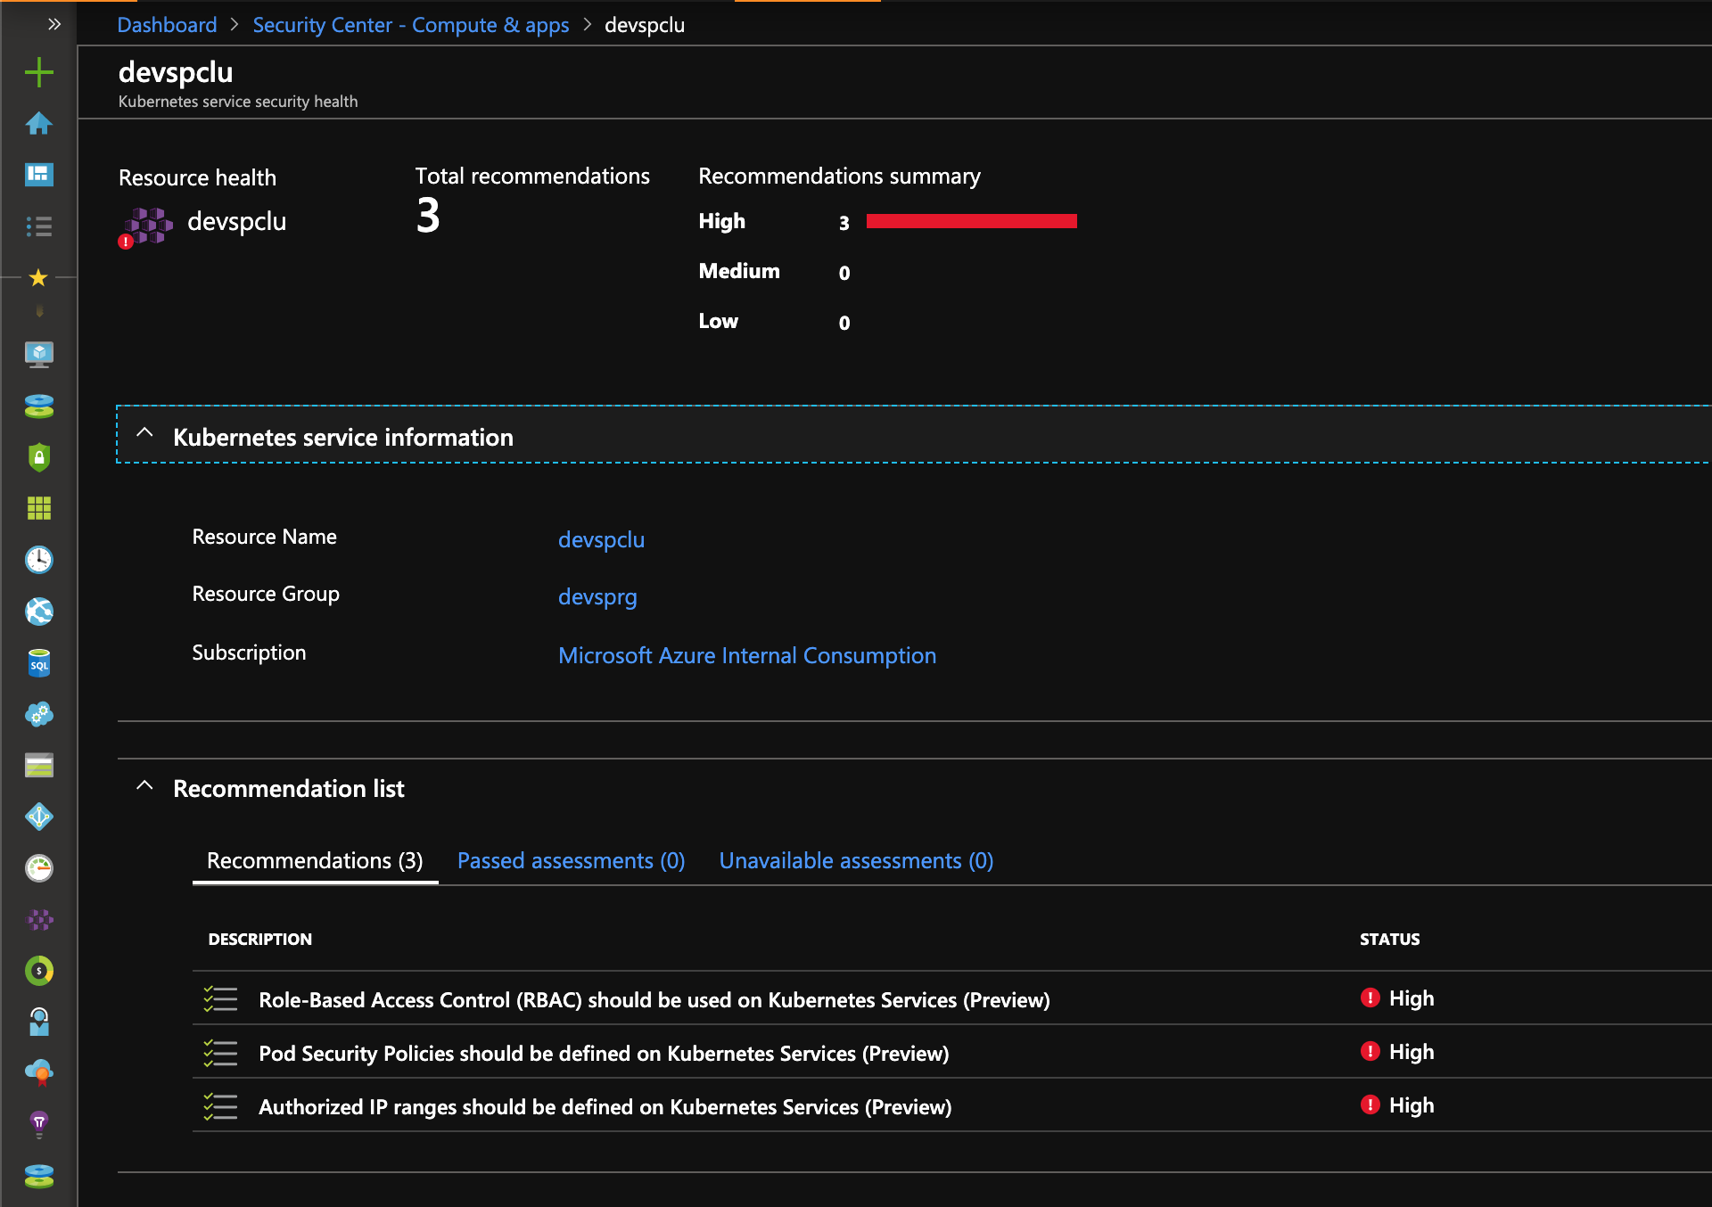
Recommendations based upon security controls enabled in AKS

Slide 59
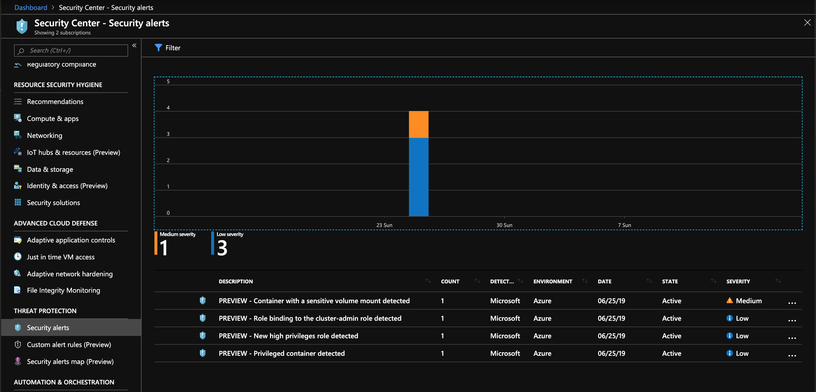
Recommendations based upon audit log analysis

Slide 60
Open Policy Agent
CNCF Hosted Sandbox Project
General purpose policy engine
Can be used across the stack
Declarative policy language (Rego)
Image: openpolicyagent.org
Notes:
Overview key features of the Open Policy Agent

Slide 61
Pop Quiz #3
I can perform actions in the Azure Security Center to remediate recommendations?
True
False
B) True?

Slide 62
Wrapping Up

Slide 63
App Before
AKS subnet
Azure Files
Web Pod(s)
Worker Pod(s)
External
Load Balancer

Slide 64

App After
Secure Registry
via Service Endpoints
Reduce Secrets Mgmt
via AAD Pod Identity
API server
Azure Container Registry
Secure access to the API Server with API whitelisting and AAD
Azure Firewall Subnet
App Gateway Subnet
AKS subnet
Web Pod(s)
Worker Pod(s)
Azure Files
Service Endpoint
Internal Load Balancer
Secure File Share Access
via Service Endpoints
Control Outbound Traffic
via Azure Firewall
Adding WAF & Ingress
No Public IP via
Internal LB
Network Segmentation
via Network Policy

Slide 65
Key Takeaways
Focus on security is a must in any Kubernetes deployment.
Help educate Security Teams on how to extend Kubernetes to integrate custom policies.
Treat the Kubernetes cluster as immutable, just like you do with applications.
Multiple ways to accomplish policy
Build all your own logic and utilize dynamic admission control
Utilize Open Policy Agent to simplify deployment and logic for rule sets.
Notes:
Talk about takeaways and what attendees learned and renforce how OPA\Policy controller solves the Problem from first few slides

Slide 66
Q&A

